Slide 1


ACME
Combined Company Profile
Altran is the undisputed global leader in Engineering and R&D services (ER&D)
45,000
EMPLOYEES
€ 2.9 bn
2017 REVENUES*
30+
COUNTRIES

Slide 2
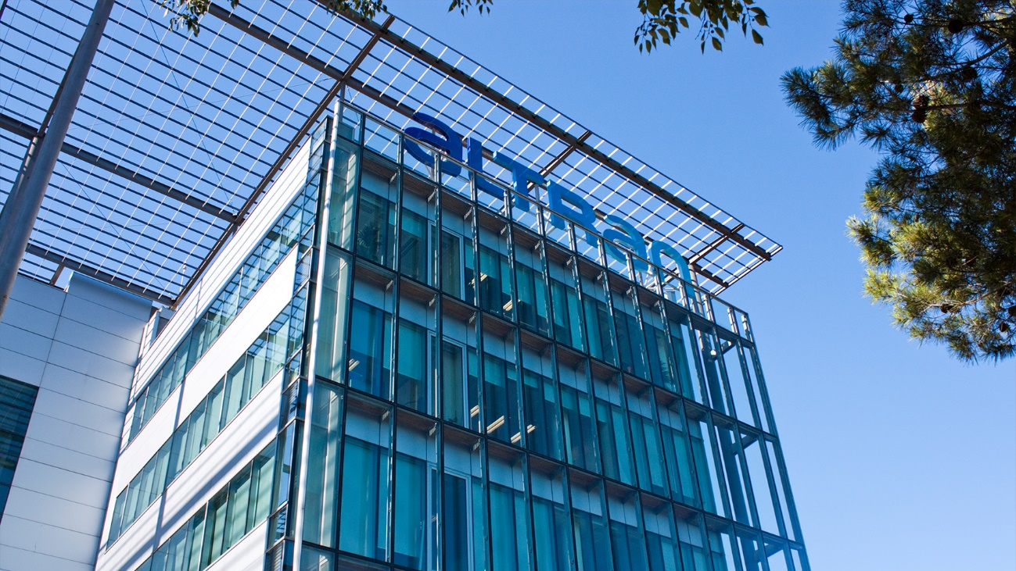
Leadership across 3 domains
ACME
Digital & Software
Product Design & Engineering
Manufacturing & Operations

Slide 3

ACME
10 Industries
Automotive
2017 REVENUE BREAKDOWN
Life Sciences
Aeronautics
10%
Finance &
Pubic Sector
Communications
17%
Automotive
Space, Defense
& Naval
15%
Hi-tech &
Software
Semiconductors
& Electronics
€2.9B
(proforma)
19%
Aerospace, Defence & Rail
Railway, Infra & Transportation
Software & Internet
21%
Telecom &
Media
Energy & Industrials
Finance &
Public Sector
18%
Energy, Industrials & Life Sciences

Slide 4

Our global reach
ACME
France
11,000
Europe
17,000
North America
1,600
Asia
14,000
MEA
1,500
45,000
EMPLOYEES AS OF TODAY
80
NATIONALITIES
90%
ENGINEERS
<32 y/o
AVERAGE AGE

